Slide 1

Budget And Expense Tracker
Presented By:
Sudarsanaa Mathan 23CSR217
Santheesh S 23CSR193
Tharaneesh Rajan N 23CSR227

Slide 2


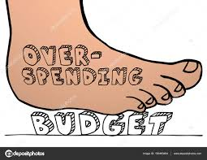
The Problem Statement
Challenges in Expense Management:
Lack of financial awareness leads to overspending.
No proper record-keeping, making it hard to track expenses.
Difficulty in setting budgets and maintaining discipline.
Manual tracking is tedious and prone to errors.
Solution:
Develop a digital solution to track expenses efficiently.
Allow users to set a budget and manage expenses in real time.
Provide visual insights on spending patterns.
Ensure ease of use with a simple, interactive interface.

Slide 3

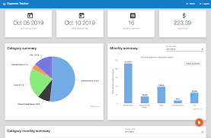
Features
Set Budget: Define a spending limit.
Add Expenses: Categorize expenses with descriptions.
View Remaining Budget: Get a real-time update.
Expense Breakdown: Categorized spending insights.
Data Visualization: Charts & graphs for better analysis.
Delete/Edit Expenses: Modify entries as needed.

Slide 4


S
Tech Stack
Frontend: HTML, CSS, JavaScript – User interface development.
Backend: Python (Flask) – Manages expense data.
Database: JSON – Stores expense records.
Visualization: Matplotlib (Python) & Chart.js – Generates charts.

Slide 5

S
WorkFlow
User Inputs Budget:
The user sets a budget limit for a specific period (e.g., daily).
The budget is stored in the backend (JSON / Database).
Adding Expenses
Amount spent
Category (Food, Transport, Shopping, etc.)
Date & Time
The data is stored in the database.
Real-Time Expense Calculation
The user can see:
Total expenses so far
Remaining balance
.
Summary & Insights
View a detailed breakdown of their expenses.
Get spending insights (e.g., top spending category).
Plan better for the next budget period.
Data Visualization:The tracker generates graphs and charts to show:
Spending patterns (e.g., pie charts for category-wise spending).
Monthly trends
.
Modify or Delete Entries
Users can edit or delete expense entries if needed.
The system updates the budget calculations accordingly.

Slide 6

S
Future Enhancements
Recurring Expenses & Bill Reminders
Set monthly rent, subscriptions, EMIs as recurring.
Send reminders before due dates.
Data Export & Reports
Export data as CSV, PDF, or Excel.
Generate monthly reports for tax or savings tracking.
Gamification & Rewards
Set spending goals and track progress.
Reward users for staying under budget.
Bank Account & UPI Integration
Auto-track transactions instead of manual entry.

Slide 7
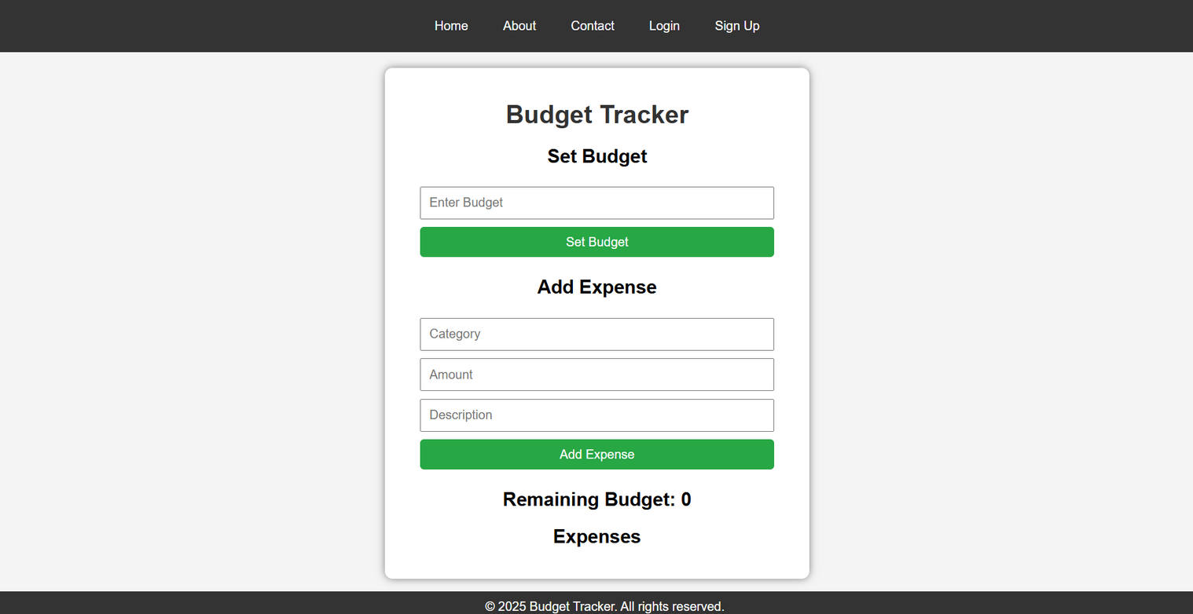
Expense Tracker
The Home Page

Slide 8
THANK YOU

